Slide 1

GADGET SHOP SYSTEM TESTING
Presentation

Slide 2
GROUP MEMBER
Sakibur Rahaman
Kazi Sifat Al Maksud
Firoz Mahmud Rizvi
2019-3-60-028
2019-3-60-050
2019-3-2-60-076
Md Al-amin
Abu Fahim Khan Shantanu
2019-1-65-003 (Sec:1)
2019-1-60-048

Slide 3
Inroduction
our system is a Gadget shop management web app. where people by sealing original products at reasonable prices such as mobile, computer, headphone, sound-box, etc.
Features
Login System
Search Item
Ordering System
product managmnet
Stock Managment
Show Bill
Admin panel
Sell Report

Slide 4

two Type of testing
Static Analysis
Dynamic Testing

Slide 5
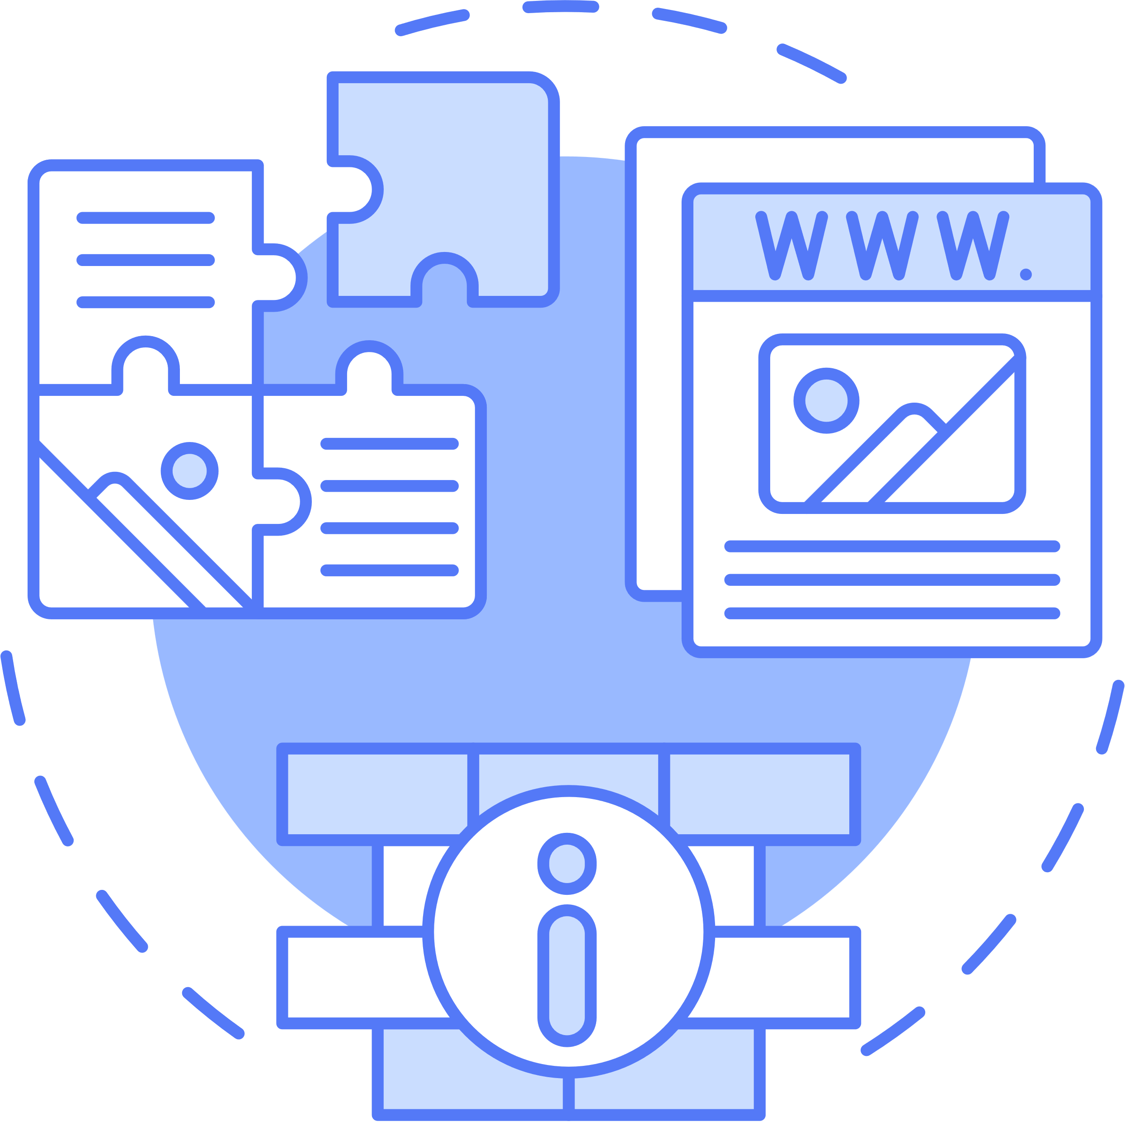
What Is Static Analysis?
Static Testing is a software testing technique which is used to check defects in software application without executing the code. Static testing is done to avoid errors at an early stage of development as it is easier to identify the errors and solve the errors.
The two main types of static testing techniques
Manual examinations
Automated analysis using tools (LTS)

Slide 6
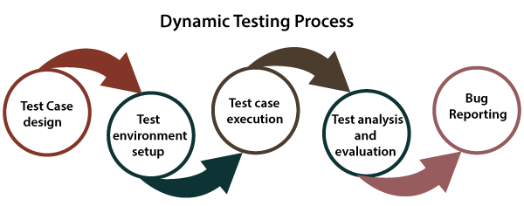
Dynamic testing
The dynamic testing is working with the software by giving input values and verifying if the output is expected by implementing a specific test case that can be done manually or with an automation process.

Slide 7
STATIC ANALYSIS
Using LTS Tools

Slide 8
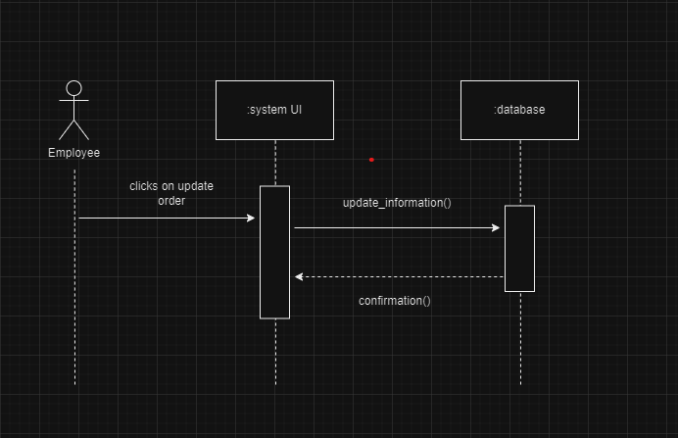
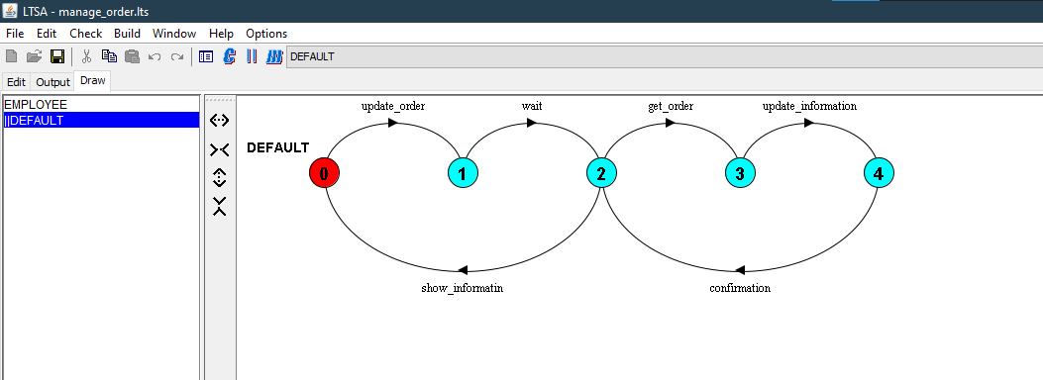
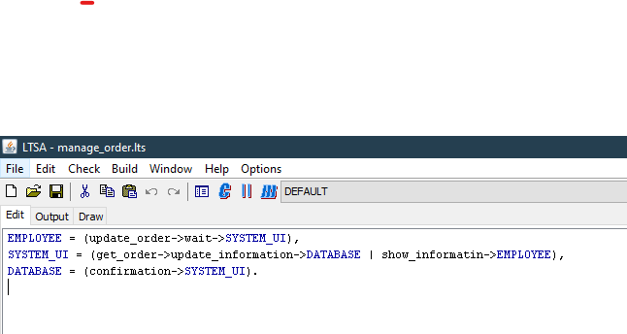
manage order

Slide 9
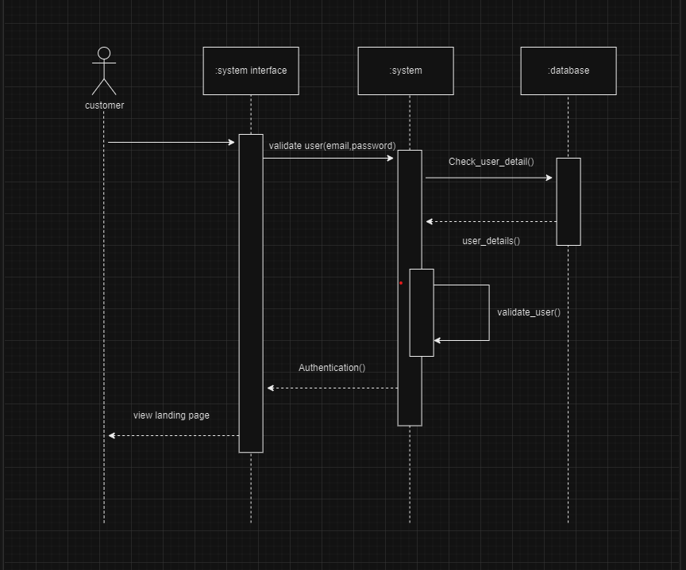
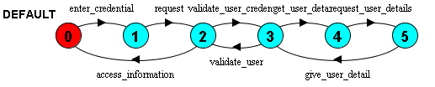

login test

Slide 10
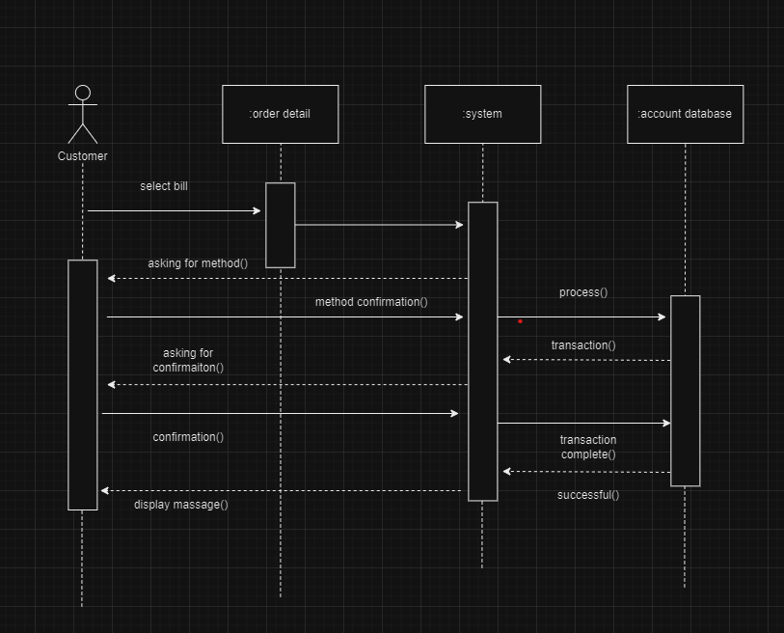
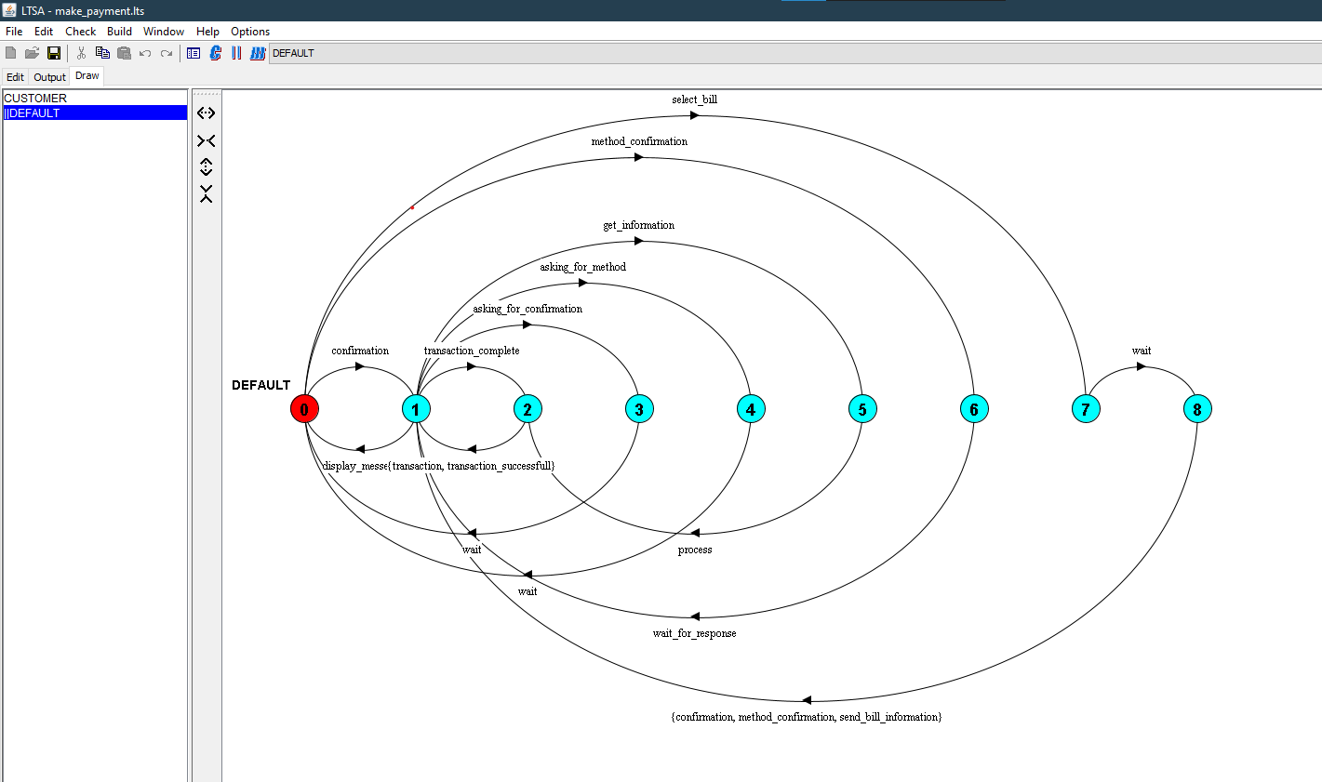
manage order

Slide 11
Dynamic test
we are create five test case on selenium for User
Test Case 1: User Login
Test Case 2: Searching Products
Test Case 3: Place Oder
Test Case 4: Registan Account
Test Case 4: Registan Account

Slide 12
Dynamic test
we also creating 3 additional test case for Admin Pannal on selenium
Test case 1: Admin Login
Test Case 2: Add Employee
Test Case 3: Add Admin

Slide 13
THANK YOU FOR LISTENING!

